Slide 1

ECE 5397/6397:
Introduction to Robotics
Lecture 2:
Rotation matrices, SO(n)
Reference: Chapter 2.1 &2.2 & Appendix B, RD&C
Instructor: Aaron Becker
Notes:
Bring Tinker Toys – show rotation matrices.
Bring a screw-driver

Slide 2
Welcome!
ROS install night: Tuesday, Jan 26, 7pm, N386
Two simple examples of hobbyists working with robot kinematics and arduinos:
2-dof arm: https://www.youtube.com/watch?v=8DVK206u0zY
6-DOF arm https://www.youtube.com/watch?v=cod_SNq-d6c
Notes:
Teleoperators from WWII to handle radioactive materials
CNC developed because of high precision required to machine certain items
----- Meeting Notes (1/21/16 12:04) -----
install night

Slide 3
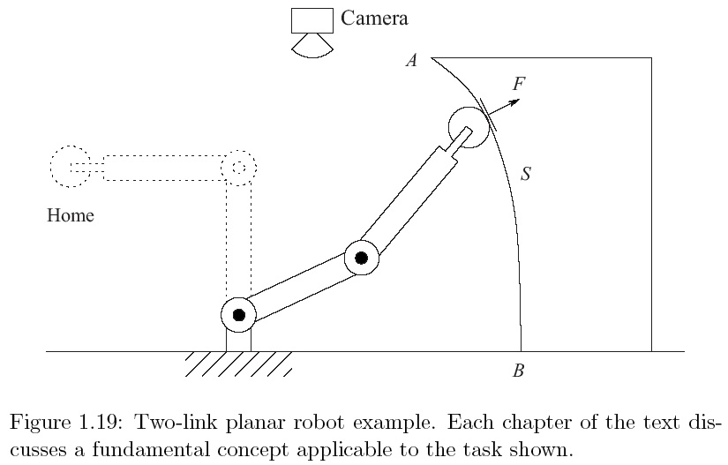
Outline Of Class
want manipulator to move from home to A to follow surface contour to B at constant velocity while maintaining force F.
Notes:
Typical Application: an industrial manipulator. This one has a metal grinding wheel, job is to remove a certain amount of material from a surface. “What are basic issues? What do we need to learn?”

Slide 4
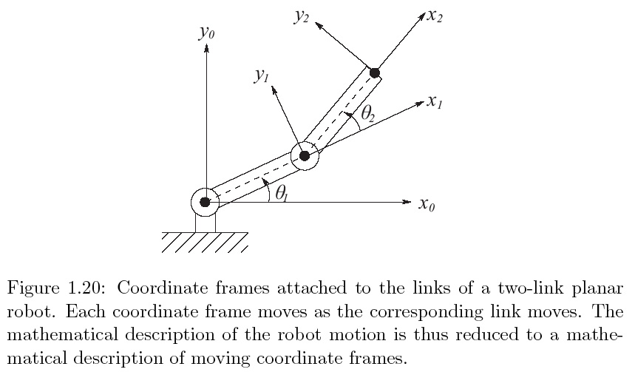
Coordinate System Ch. 2
Describe position of tool, A, B in common coordinate system (Ch. 2: coordinate sys. and transformations)
Typically robot has sensors to measure θ_{1,} θ_{2,} Forward Kinematics: determine position and orientation of end effector or tool in terms of joint variables

Slide 5
Forward Kinematics Ch. 3.2
a₂
a₁
Notes:
Do this on the board

Slide 6
Forward Kinematics Ch. 3.2
Location of end effector
a₂
a₁
Orientation of tool frame found by projecting coordinate frame 2 onto 0:
Rotation matrix:
Orientation of coordinate frame 2 according to coordinate frame 0
Notes:
Redo the rotation for x1, then x2 on the board
We will use homogenous coordinates and homogenous transformations to simplify

Slide 7
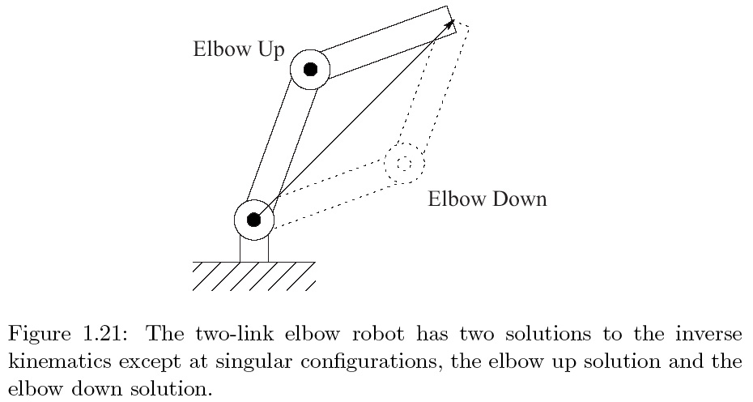
Inverse Kinematics Ch. 3.3
To command the robot to move to A we need to determine θ_{1,} θ_{2.} [nonlinear equations to invert]
Notes:
Elbow up/ elbox down

Slide 8
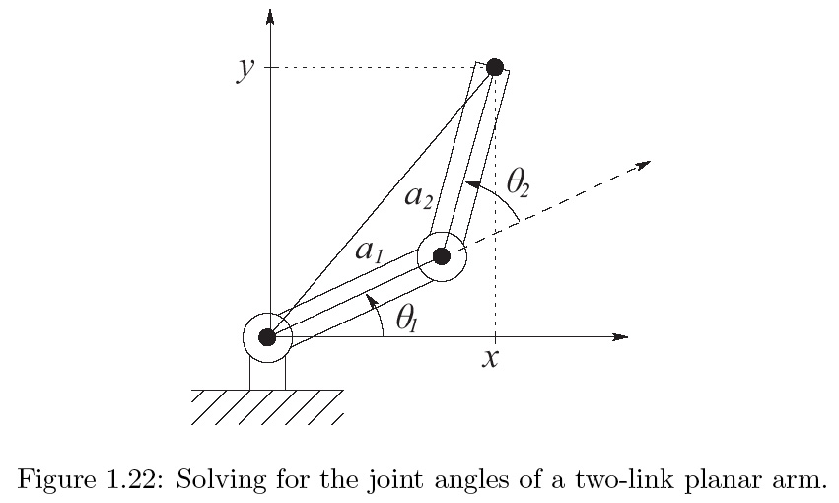
Inverse Kinematics Ch. 3.3

Slide 9
Inverse Kinematics Ch 3.3
Law of cosines: triangle sides a,b,c, and angle opposite c is θ_{c,}
Rotation matrix

Slide 10
Velocity Kinematics Ch 4
Differentiate kinematic equations:
J = Matrix Jacobian

Slide 11
Inv. Velocity Kinematics Ch. 4
Notes:
Determinate By addition identity

Slide 12
How many solutions to the inverse kinematics problem are there?
4 regimes:
Notes:
Inf. Solutions
2 solutions
1 solution
0 solutions

Slide 13
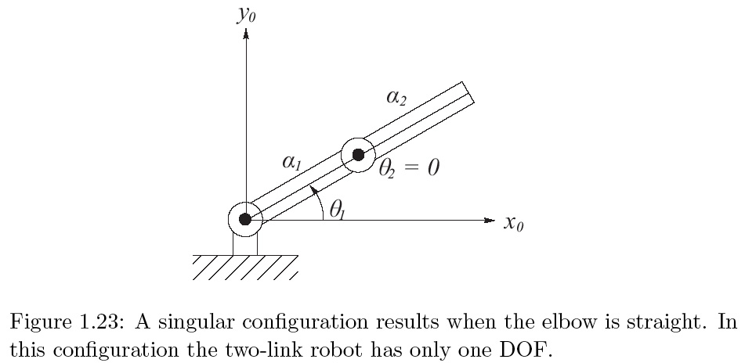
Singular Configurations Ch. 4

Slide 14
In class worksheet
Pretend this is a quiz.
You have 15 minutes to accomplish as much as possible.
Then, we will exchange sheets and “grade” it
This will tell you what you need to review.
Notes:
15’ hdmi cord

Slide 15
Quiz answers (write correct answer)

Slide 16
Quiz answers (write correct answer)

Slide 17
Quiz answers (write correct answer)
Notes:
----- Meeting Notes (1/21/16 12:53) -----
alpha is a scalar, x and y are vectos (fix WS

Slide 18
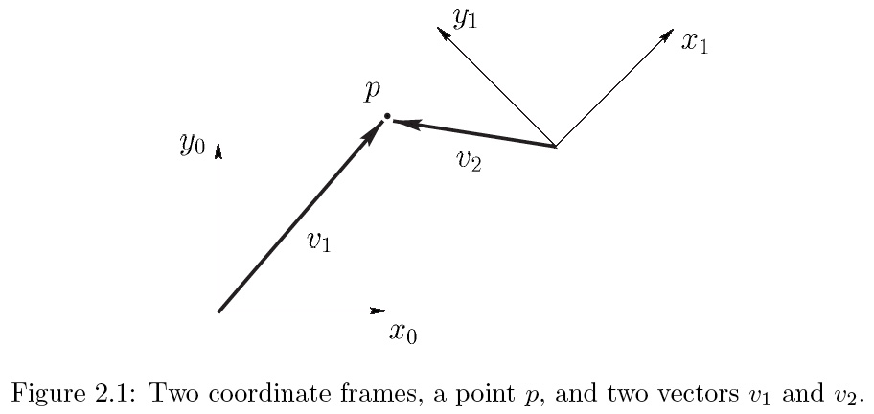
Representing Positions
Synthetic approach: reasons about geometric entities (points, lines, etc.)
Analytic approach: represent entities with coordinates or equations, reasoning via algebraic manipulation. Requires a coordinate frame:
Notes:
Coordinate frame: an origin (single point in space) and two or three orthogonal axes for 2d or 3d space
Synthetic approach: x0 and y0 are orthogonal. Xo cross yo is perpendicular to page.

Slide 19
Representing Positions
6
5
5
10

Slide 20
Representing Positions
4.2
3.5
6
5
-2.8
5
10
-10.6
Notes:
----- Meeting Notes (1/21/16 12:53) -----
fix this

Slide 21
Vectors = free vectors
4.2
3.5
6
5
-2.8
5
10
-10.6
Notes:
On board: points refer to specific locations in space, a vector can be moved to any location

Slide 22
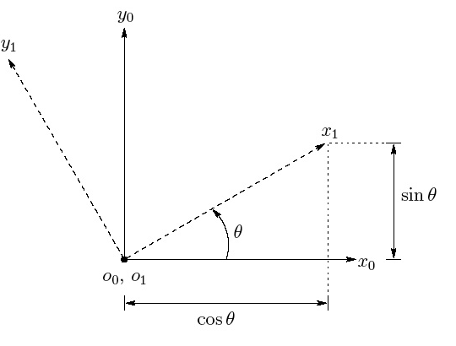
Rotation in the plane
o₁x₁y₁ obtained by rotating o₀x₀y₀ by θ
Problems:
discontinuity at θ = 2π
What do we do in 3D?
This is a rotation matrix
Notes:
Write out R01

Slide 23
Rotation Matrix
Show this is commutative
Because column vectors are unit length and mutually orthogonal the matrix is orthogonal
A such n x n matrices are called SO(n), Special Orthogonal group of order n
Notes:
From page 40

Slide 24
Properties of SO(n)
such n x n matrices are called SO(n), Special Orthogonal group of order n
Properties
Notes:
Page 41

Slide 25
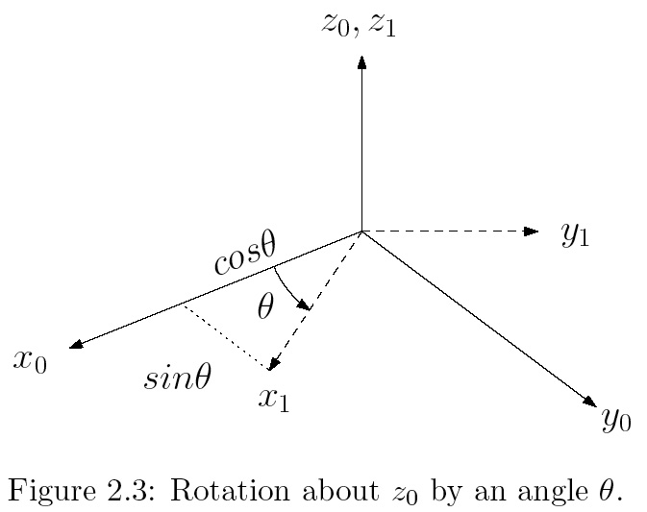
Rotation in Three Dimensions
A basic rotation matrix
3 properties:
Notes:
2.3
2.4
2.5
Page 42

Slide 26
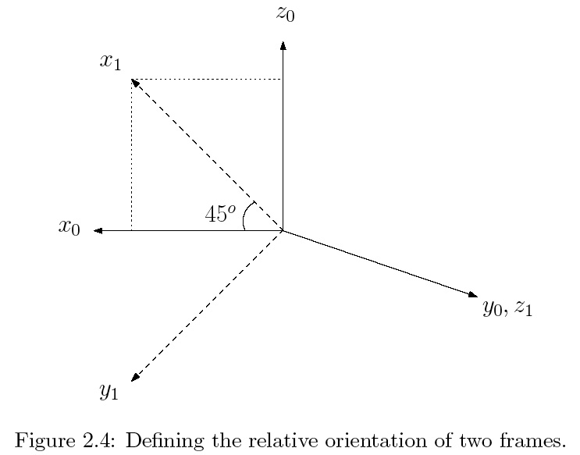
02_04
Relative Orientation
02_04
Notes:
02_04.jpg

Slide 27
Summary
Reviewed Vectors from Linear Algebra
Representing Positions
Representing Rotations

Slide 28
For the Next Class
Study Sections 2.3,2.4,2.7 & Appendix B for Lecture 3
This is important: I want you to come prepared for each class by reading ahead, and have an idea of what to expect
Write down your questions and bring them with you
I may do a quiz in class based on your assigned reading
This is good for you
Advance reading will help you grasp the subject with much less effort

